Slide 1
Business Intelligence Framework
for Sales Performance
Large Restaurant Chain – Dine-in, Pick-up, Delivery

Slide 2
Introduction
Challenges faced by restaurant chains:
-Monitor sales in real time across branches
-Customer demand changes suddenly (busy hours, holidays)
-Delivery delays from traffic or bad weather
-Higher food costs and wastage
-Competitor offers reduce sales
Solution: Business Intelligence (BI) framework to integrate data and provide insights
Goal: Provide insights via dashboards & OLAP cubes for better decisions

Slide 3
Objectives
Improve service efficiency (reduce delivery time, improve order handling)
Increase profit margins (reduce wastage, optimize pricing)
Enhance competitiveness (monitor competitor performance)
Support decisions with dashboards & OLAP cubes

Slide 4
BI Framework
Data Flow:
1. Data Sources →
2. ETL Process →
3. Data Warehouse (Star Schema) →
4. OLAP Cubes →
5. Dashboards & Reports

Slide 5
Data Sources
Operational Data:
- Sales transactions (dine-in, pickup, delivery)
- Employee performance & schedules
- Inventory/stock levels
External Data:
- Weather data (affects delivery demand)
- Public holidays (affect dine-in demand)
- Competitor pricing/promotions
- Traffic data (affects delivery times)

Slide 6


ETL Process & Warehouse
ETL Process: Extract → Transform → Load
Data Warehouse: Star Schema with Fact & Dimension Tables
Fact Tables: Fact_Sales
Dimensions:
-DimCustomer
-DimEmployee
-DimBranch
-DimProduct
-DimDate
-DimTime
​-Dim Competitor

Slide 7
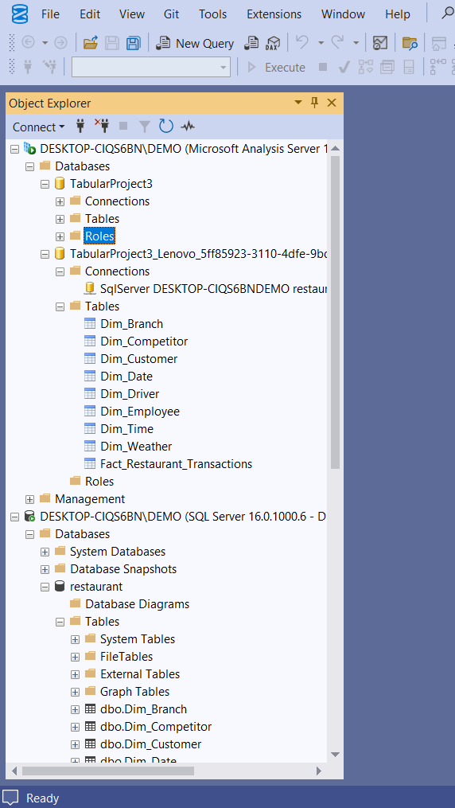
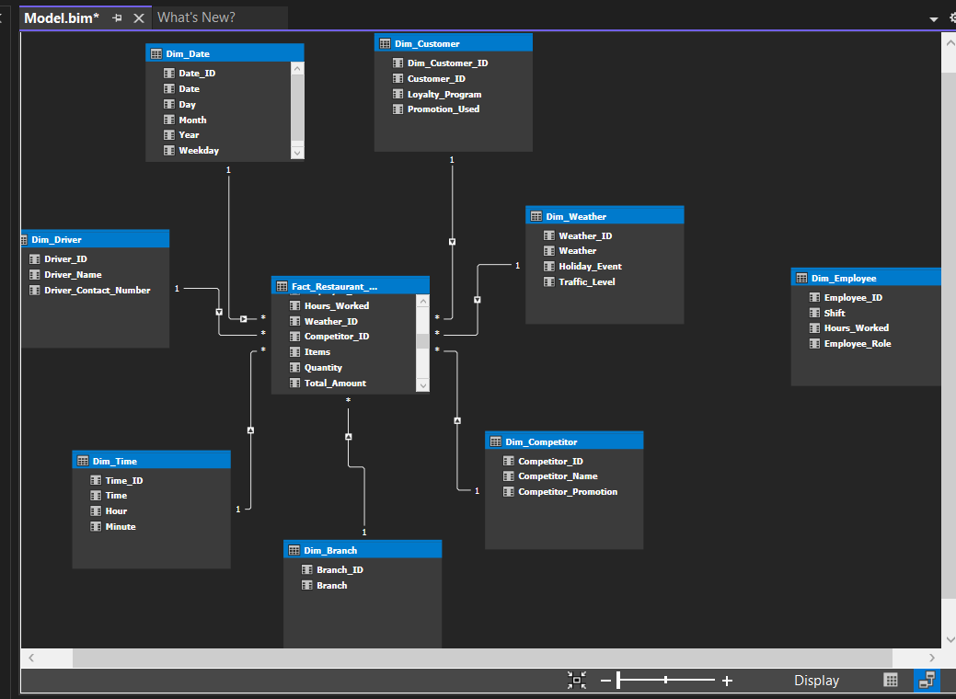
ETL Process & Warehouse

Slide 8

OLAP Cubes(SSAS)
Sales Performance OLAP Cube
Measures:
Average Competitor Price
Average Competitor Feedbacks
Average Delivery Time
Sales Growth%
Average Stock Level
Average Order Values
Sales Today
Dimensions:
Branch
Competitors
Customer
Date
Time
Employee
Weather

Slide 9
DASHBOARD

Slide 10
Future Sales Decisions
Win Customers → Loyalty programs & offers
Boost Delivery → Faster, promote online orders
Branch Focus → Begin support branches Jaffna & Kalutara
Smart Workforce → Balance staff hours
Cut Wastage → Better stock control
Growth Target → Aim 5–10% yearly increase

Slide 11
THANK YOU

